Slide 1



SPEECH EMOTION RECOGNITION DURING LIVE CALLS WHILE CREATING EVENTS
DEPARTMENT OF ARTIFICIAL INTELLIGENCE & DATA SCIENCE
1.927621BAD026 -LAVANYA DEVI.K
2.927621BAD029-MADHUMITHRA.M
3.927621BAD030-MAHALAKSHMI.R
4.927621BAD063-YUVASHREE.S
GUIDED BY : Mr.R.STALINBABU
AP/AI&ML

Slide 2
ABSTRACT
The aim of the project is about the detection of the emotions elicited by the speaker while talking. As an example, speech produced in a state of fear, anger, or joy becomes loud and fast, with a higher and wider range in pitch, whereas emotions such as sadness or tiredness generate slow and low-pitched speech.
Detection of human emotions through voice pattern and speech-pattern analysis has many applications such as better assisting human-machine interactions.
To recognize emotions based on speech i.e., the audio files, Input will be the audio files and the output will be different kinds of emotions.
Based on the voice modulation, pitch and other audio attributes, we are going to classify which emotion it conducts.

Slide 3
LITERATURE SURVEY
Narayanan proposed domain specific on “EMOTION RECOGNITION”,by utilizing speech signals from call center.
Different types of information includes ACOUSTIC, LEXICAL & DISCOURSE are used for emotion recognition.
SURVEYED BY:
S. S. Narayanan, “Toward detecting emotions in spoken dialogs,” IEEE Trans. Speech Audio Process., vol. 13,no. 2, pp. 293–303, Mar. 2005.

Slide 4
SURVEY
Chen et al. aimed to improve speech emotion recognition in speaker-independent with three level speech emotion recognition method. This method classify different emotions from coarse to fine then select appropriate feature by using Fisher rate. The output of Fisher rate is an input parameters for multi- level SVM based classifier.
SURVEYED BY:
L. Chen, X. Mao, Y. Xue, and L. L. Cheng, “Speech emotion recognition: Features and classification models,”.Digit. Signal Process., vol. 22, no. 6, pp. 1154–1160, Dec. 2012.

Slide 5
SURVEY
Albornoz et al investigate a new spectral feature in order to determine emotions and to characterize groups.
In this study based on acoustic features and a novel hierarchical classifier, emotions are grouped. Different classifier such as HMM, GMM and MLP have been evaluated with distinct configuration and input features to design a novel hierarchical techniques for classification of emotions
SURVEYED BY
E. M. Albornoz, D. H. Milone, and H. L. Rufiner, “Spoken emotion recognition using hierarchical classifiers,” Compute Speech Lang., vol. 25, no. 3, pp. 556–570, Jul. 2011.

Slide 6
SURVEY
Rong et al presented an ensemble random forest to trees (ERFTrees) method with a high number of features for emotion recognition without referring any language or linguistic information remains an unclosed problem. This method is applied on small size of data with high number of features. In order to evaluate the proposed method an experiment results on a Chinese emotional speech dataset designate
SURVEYED BY
J. Rong et al “Acoustic feature selection for automatic emotion recognition from speech,” Inf. Process. Manag., vol. 45, no. 3, pp. 315–328, May 2009.

Slide 7
MODULES OF THE PROJECT

Slide 8
MODULES CLASSIFICATION
DATA PREPARATION & ABSTRACTION AND VOICE SAMPLE COLLECTION- MODULE 1
EMOTION AND CLASSIFICATION-MODULE 2
SPEECH EMOTION RECOGNITION (SER) & COMBINING INFORMATION SOURCES-MODULE 3
EXPERIMENTAL RESULT AND ANALYSIS-MODULE 4

Slide 9
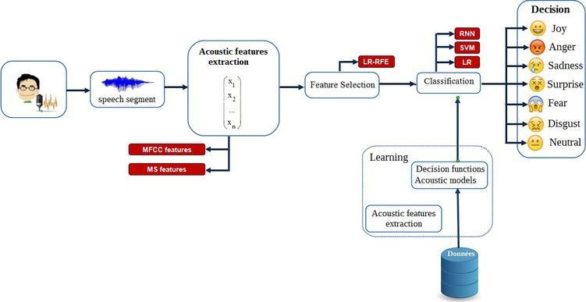
BLOCK DIAGRAM

Slide 10
REFERENCES
https://www.analyticsinsight.net/speech-emotion-recognition-ser-through-machine-learning/
https://www.kaggle.com/code/shivamburnwal/speech-emotion-recognition#:~:text=Emotion%20%2801%20%3D%20neutral%2C%2002,sitting%20by%20the%20door%22%29
https://www.projectpro.io/article/speech-emotion-recognition-project-using-machine-learning/573
https://www.mygreatlearning.com/academy/learn-for-free/courses/introduction-to-natural-language-processing

Slide 11
THANK YOU

